Slide 1


Unsupervised Machine Learning
Dr Mpho Mokoatle
09 July 2026

Slide 2

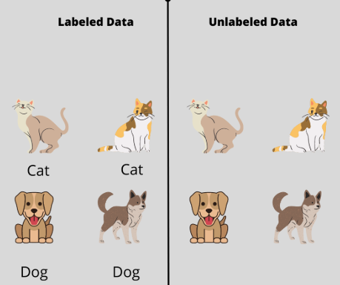
What is Unsupervised Machine Learning?
Unsupervised learning is a type of machine learning where the model works without labelled data.

Slide 3
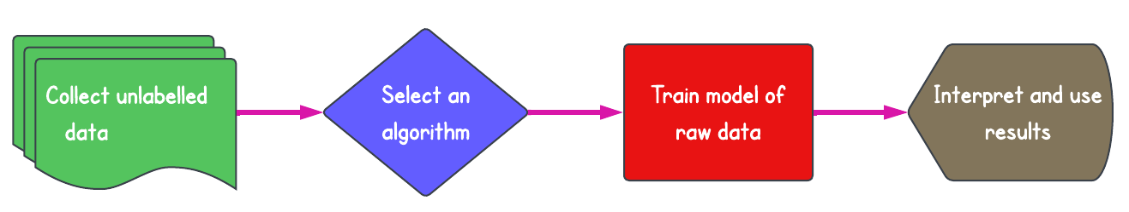
Unsupervised Machine Learning Steps
The working of unsupervised machine learning can be explained in these steps:

Slide 4
Applications of Unsupervised Learning
Customer segmentation: Group customers with similar characteristics for targeted marketing.
Image segmentation: Identify objects within an image.
Anomaly detection: Detect unusual patterns in data.
Dimensionality reduction: Reduce complex data sets for easier visualisation and analysis.
Genetics - clustering DNA patterns to analyse evolutionary biology.

Slide 5
Unsupervised Learning Techniques
We will explore three key techniques:
1. Clustering: K-means, K-medoids, Fuzzy Clustering
2. Dimensionality reduction: PCA and t-SNE
3. Association Rule Learning

Slide 6
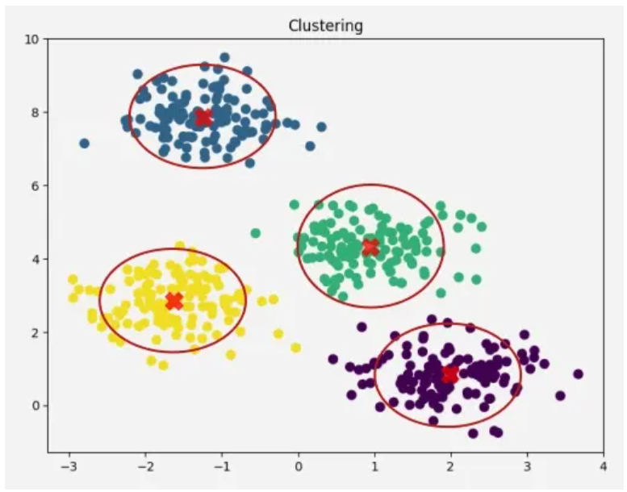
Clustering Algorithms
Clustering is an unsupervised machine learning technique that groups unlabeled data into clusters based on similarity. Its goal is to discover patterns or relationships within the data without any prior knowledge of categories or labels.

Slide 7
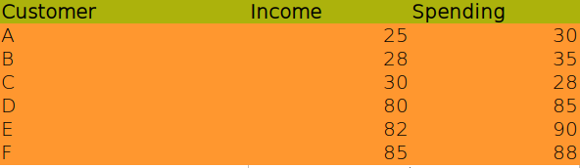
K-means Clustering
K-Means is an unsupervised machine learning clustering algorithm that groups similar data points into clusters without needing labeled data. It is used to uncover hidden patterns when the goal is to organize data based on similarity.
Example: Suppose a clothing store wants to divide its customers into groups based on:Annual Income, and Annual Spending
The data looks like this:

Slide 8
K-means Clustering cont.
Step 1 Choose the number of clusters (k): We begin by choosing the number of clusters (k). Suppose we choose k=2. This tells the k-means algorithm to find two clusters.
Step 2 Initialise the Centroids: A centroid is the center of a cluster. Each data point is assigned to the nearest centroid, forming clusters. Initially, the algorithm choose two centroids randomly from the data. Say it selects:
Centroid 1 = Customer A = (25,30)
Centroid 2 = Customer D = (80,85)

Slide 9

K-means Clustering cont.
Step 3 Compute the distance to each centroid: K-means usually uses the euclidean distance:
Let's calculate the distances for Customer B.
Distance to Centroid 1 (25,30) ~ 5.83
Distance to Centroid 2 (80,85) ~ 72.14.

Slide 10
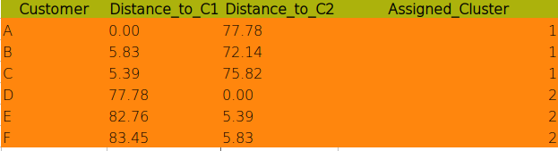
K-means Clustering cont.
Since 5.83 < 72.14, Customer B belongs to Cluster 1. This process is repeated for every customer:
Now, the clusters are:
Cluster 1: A, B, C
Cluster 2: D, E, F

Slide 11

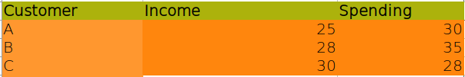
K-means Clustering cont.
Step 4 Update the Centroids: The centroid becomes the mean of all points in the cluster.
For cluster 1
Mean income = 27.67
Mean spending = 31
New centroid_1: (27.67,31)
= the new centroid cluster i

Slide 12
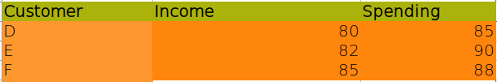
K-means Clustering cont.
Step 4 Update the Centroids: The centroid becomes the mean of all points in the cluster.
For cluster 2
Mean income = 82.33
Mean spending = 87.67
New centroid_2: (82.33,87.67)
Step 5 Repeat: Now the algorithm again computes distances using the new centroids. This process continues until no observations change clusters, or the centroids no longer move significantly. This is called convergence.
= the new centroid cluster i

Slide 13
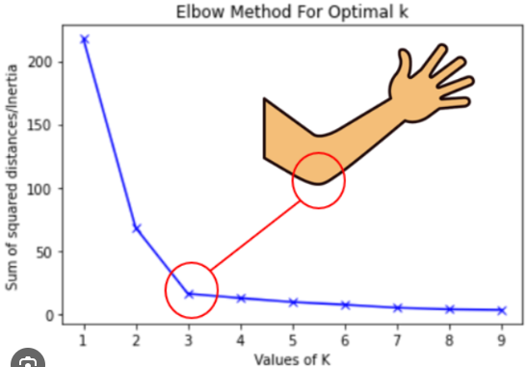
The Elbow Method.
The Elbow Method is used to find the optimal number of clusters (k) in K-Means by analyzing how the clustering performance changes with different k values.
Why do we use the Elbow Method? When using K-Means, the algorithm cannot automatically determine how many clusters exist in the data. You must specify the value of K before training.

Slide 14


Working of Elbow Point
The Elbow Method works in the following steps:
1. We begin by selecting a range of k values (for example, 1 to 10).
2. For each k, calculate WCSS (Within-Cluster Sum of Squares), which shows how close the data points are to their cluster centroids:
= number of clusters
= the set of point belonging to cluster
= a data point in cluster
= the centroid (mean) of cluster
= squared Euclidean distance between point x and its cluster centroid

Slide 15
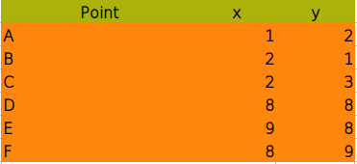
The Elbow Method Example
Suppose we have these 2D data points:
Step 1:
We test a range of k values. Suppose when k=2, k-means grouped them as:
Cluster 1: A(1,2), B(2,1), C(2,3)
Cluster 2: D(8,8), E(9,8), F(8,9)

Slide 16



The Elbow Method cont.
Step 2: Compute the Within-Cluster Sum of Squares (WCSS).
Find the centroid of each cluster:
Cluster 1: A(1,2), B(2,1), C(2,3)
Centroid 1 = (1.667, 2)
Cluster 2: D(8,8), E(9,8), F(8,9)
Centroid 2 = (8.333, 8.333)

Slide 17



The Elbow Method cont.
Step 2b) Calculate the squared euclidean distance of each point to its centroid:
Cluster 1, Centroid 1 = (1.667, 2)
WCSS₁ = 0.444 + 1.111 + 1.111 = 2.667
Cluster 2, Centroid 2 = (8.333, 8.333)
WCSS₂ = 0.222 + 0.556 + 0.556 = 1.333
Total WCSS:
WCSS=WCSS₁+ WCSS₂ =2.667+1.333= 4.0
That is the quantity the Elbow Method plots against different values of K.

Slide 18
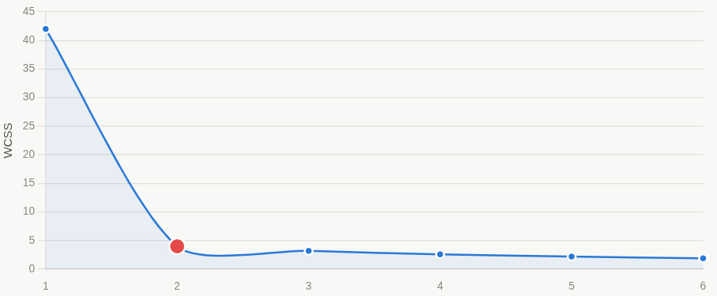
The Elbow Method cont.
Here's an example of the elbow method plot, showing WCSS against different values of k.

Slide 19

K-means clustering Advantages.
See python code implementation here.
Advantages
Relatively simple to implement.
Scales to large data sets.
Always converges.

Slide 20

K-means Clustering Disadvanges.
2. Disadvantages
Manual K Selection
Sensitivity to Initial Centroids
Vulnerable to Outliers
Curse of Dimensionality

Slide 21
K-Medoids Clustering
K-Medoids or Partitioning Around Medoids (PAM) is an unsupervised clustering algorithm that is very similar to K-Means.
The main difference is:
- K-Means represents each cluster by its centroid (mean).
- K-Medoids represents each cluster by an actual observation (medoid) from the dataset.
What is a Medoid? A medoid is the observation within a cluster whose total distance to all other observations in that cluster is the smallest.

Slide 22
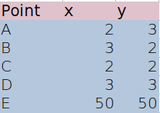

K-Medoids Clustering cont.
Example: Suppose we have five data points:
The centroid is approximately:
However, (12,12) is not one of the original observations. The medoid, would probably be C(2,2) because it is the point with the smallest overall distance to the others in the main group.
Unlike K-Means, k-medoids selects actual observations. K-means typically uses the Euclidean distance only while K-Medoids can use any distance metric such as Euclidean, Manhattan, cosine, etc.

Slide 23
K-Medoids Clustering Advantages
K-medoids python implementation.
Advantages
Robustness to Outliers: Most often, medoids are less prone to outliers and noises than centroids.
Flexibility in Distance Metrics: Others can use any distance measurement, not limited to the Euclidean distance measurement, making it general for all data types.

Slide 24
K-Medoids Clustering Disadvantages
2. Disadvantages
Computationally Intensive: K-Medoids is relatively slower than K-Means due to its higher complexity when working with larger databases.
Complexity: It is also more difficult to implement and understand than K-Means, even though it is a more effective clustering method.

Slide 25

Fuzzy Clustering
Unlike K-Means and K-Medoids, where each data point belongs to exactly one cluster, Fuzzy Clustering allows a data point to belong to multiple clusters simultaneously with different degrees of membership.
The membership values always sum to 1.

Slide 26
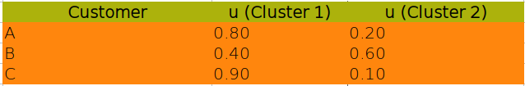
Fuzzy C-Means Clustering Example.
Example: Suppose you are clustering customers based on their income and spending habits.
Step 1: Initialize membership values randomly, they must sum to 1 per row:

Slide 27
Fuzzy C-Means Clustering Example cont.
Step 2: Define the number of clusters c you want and the fuzziness coefficient m. m dictates how "soft" or overlapping your cluster boundaries are. Higher m = fuzzier.
Let's say c=2, and m = 2. Learn more about other parameters here:

Slide 28



Fuzzy C-Means Clustering Example cont
Step 3 Compute the centroids weighted by:
Cluster 1 (weights = 0.64, 0.16, 0.81 → sum = 1.61):
Income: (0.64×25 + 0.16×28 + 0.81×30) / 1.61 = 27.81
Spending: (0.64×30 + 0.16×35 + 0.81×28) / 1.61 = 29.49, Centroid 1 (C1) = (27.81, 29.49)
Cluster 2 (weights: 0.04, 0.36, 0.01 → sum = 0.41):
Income: (0.04×25 + 0.36×28 + 0.01×30) / 0.41 = 27.76
Spending: (0.04×30 + 0.36×35 + 0.01×28) / 0.41 = 34.34, Centroid 2 (C2) = (27.76, 34.34)

Slide 29

Fuzzy C-Means Clustering Example cont
Step 4 Compute distances using the standard Euclidean distance, but now measured to the new fuzzy centroids from step 3:
Recall the new centroids from Step 3:
Centroid 1 (C1) = (27.81, 29.49)
Centroid 2 (C2) = (27.76, 34.34)
For customer A (25,30) using centroid 1:
For customer A (25,30) using centroid 2:

Slide 30
Fuzzy C-Means Clustering Example cont.
Step 4 Compute distances using the standard Euclidean distance, but now measured to the new fuzzy centroids from step 3:
Recall the new centroids from Step 3:
Centroid 1 (C1) = (27.81, 29.49)
Centroid 2 (C2) = (27.76, 34.34)
For customer B (28,35) using centroid 1:
For customer B (28,25) using centroid 2:
Repeat for customer C

Slide 31
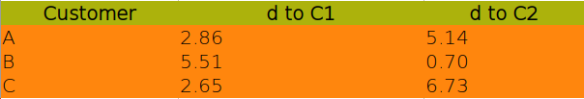
Fuzzy C-Means Clustering Example cont.
Step 4 Compute distances using the standard Euclidean distance, but now measured to the new fuzzy centroids from step 3:
Summary table from step 4:

Slide 32



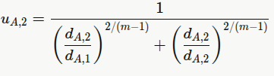




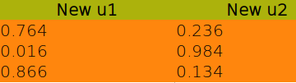
Fuzzy C-Means Clustering Example cont.
Step 5 Update memberships u1 and u2:
Recall A's distances to cluster 1, = 2.86, and cluster 2, = 5.14
Using the formula: ,
,
The membership values always sum to 1.

Slide 33
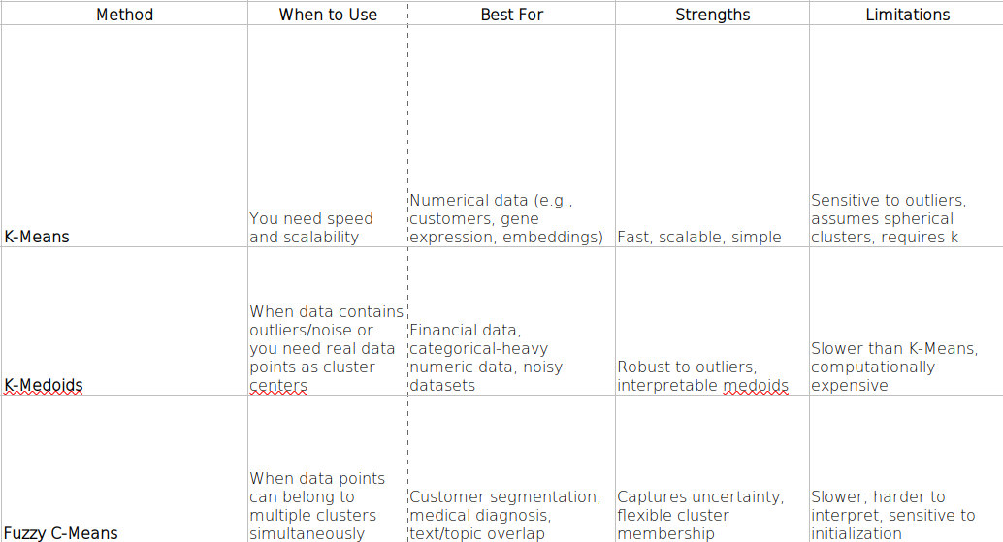
When to choose which model

Slide 34
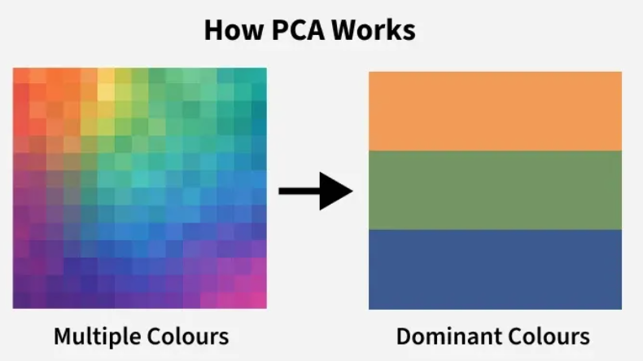
Principal Component Analysis (PCA)
PCA (Principal Component Analysis) is a dimensionality reduction technique and helps us to reduce the number of features in a dataset while keeping the most important information. It changes complex datasets by transforming correlated features into a smaller set of uncorrelated components.

Slide 35
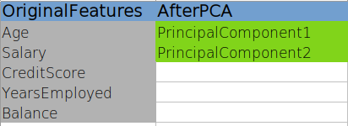
Principal Component Analysis (PCA) cont.
PCA is not a clustering algorithm. Instead, it is often used before clustering to make clustering algorithms work better, especially when dealing with high-dimensional data.
Think of PCA as a data preparation (preprocessing) step, while K-Means, K-Medoids, and Fuzzy C-Means are the algorithms that actually group the data.
Example:

Slide 36

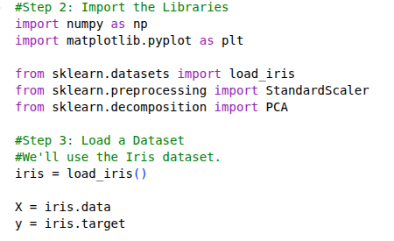
Principal Component Analysis (PCA) Python Implementation
Step 1: Install the libraries
Step 2 & 3: Import the libraries and load the dataset.

Slide 37

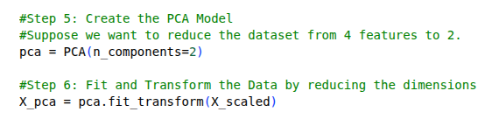
Principal Component Analysis (PCA) Python Implementation cont.
Step 4: Standardise the data
Step 5 & 6: Fit the PCA model and reduce the dimensions

Slide 38
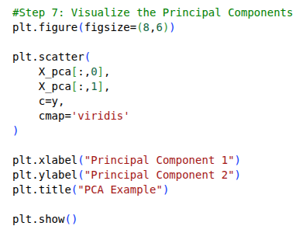
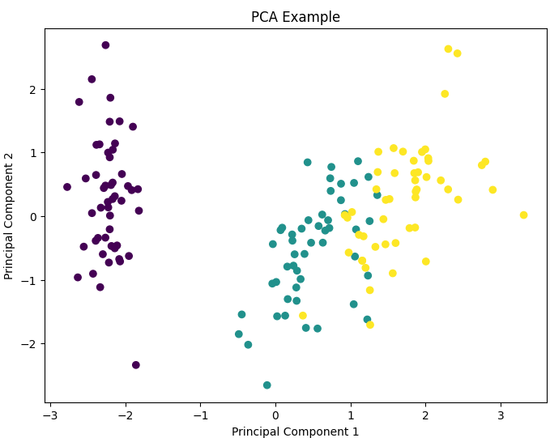
Principal Component Analysis (PCA) Python Implementation cont.
Step 7: Visualise the Principal components

Slide 39


Principal Component Analysis (PCA) Python Implementation cont.
Step 8: One of the most useful outputs of PCA is the proportion of variance explained by each principal component called the Explained Variance Ratio.
Meaning the first two principal components preserve approximately 95.8% of the information in the original dataset.

Slide 40


Principal Component Analysis (PCA) Python Implementation cont.
Step 9: View the Principal Components
These values (called loadings) show how much each original feature contributes to each principal component.

Slide 41
T-distributed Stochastic Neighbor Embedding (t-SNE) Algorithm
T-distributed Stochastic Neighbor Embedding (t-SNE) is a non linear dimensionality reduction technique used for visualizing high-dimensional data in a lower-dimensional space mainly in 2D or 3D.
How is t-SNE different from PCA? PCA and t-SNE are both dimensionality reduction techniques used in machine learning and data visualization. However, PCA assumes linear relationships and may not capture complex, non-linear patterns in the data. On the other hand, t-SNE is a non-linear dimensionality reduction technique.

Slide 42
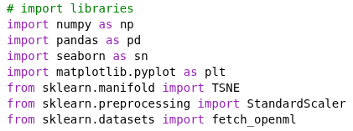
t-SNE Algorithm Python Implementation
Now let's use the sklearn implementation of the t-SNE algorithm on the MNIST dataset which contains 10 classes that are for the 10 different digits in the mathematics.
Step 1 Import libraries:

Slide 43
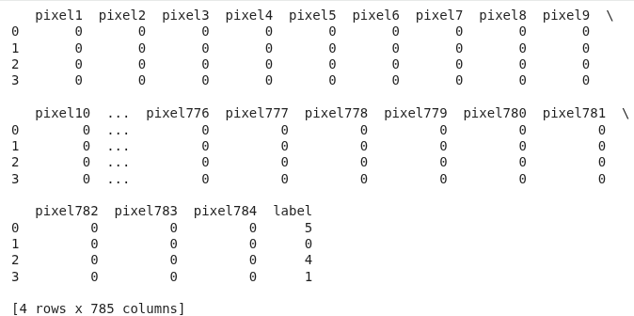
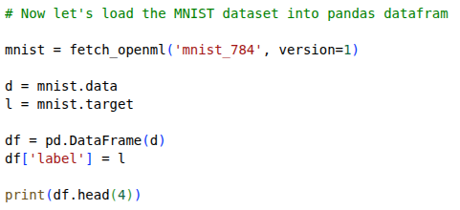
t-SNE) Algorithm Python Implementation cont.
Step 2: Load the MNIST data

Slide 44
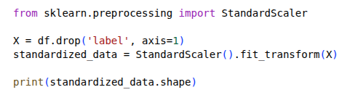
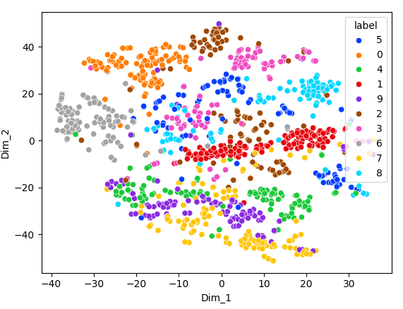
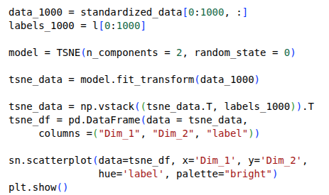
t-SNE Algorithm Python Implementation cont.
Step 3: Standardise data, apply t-SNE, and plot

Slide 45
When to use PCA vs t-SNE?
Use PCA when:
You require faster computation
You require feature reduction
You need input for ML models
You need interpretable components
When you have a large dataset
Use t-SNE when:
You want visualization only
You want to explore clusters in embeddings
You have high-dimensional data (e.g., 50–300D+)

Slide 46

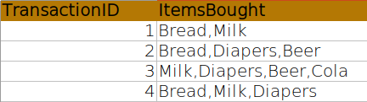
Association Rule Learning
An unsupervised machine learning technique used to discover interesting relationships or associations between variables in large datasets.Can be used to answer a question like: If a customer buys X, how likely are they to also buy Y?
Generate rules like:
Example:
Let's look at a supermarket example:
Association rule learning might discover the following relationship:
if someone buys bread, they are likely to buy milk. Most common algorithms include the Apriori
algorithm, Eclat algorithm, and FP-Growth
Algorithm. Python Code implementation
When to use Association Rule Learning? When you want to find relationships between items (co-occurrence patterns).

Slide 47

THANK YOU

